Slide 1

Artificial Intelligence CSC462
Instructor Shehar Bano
COMSATS University Islamabad Wah Campus.
shehar.bano@ciitwah.edu.pk
Modified slides of Dan Klein and Pieter Abbeel (http://aima.cs.berkeley.edu)

Slide 2
RECAP:What we studied before!
Explore whole state space graph systematically.
This systematicity is achieved by
keeping one or more paths in memory and
by recording which alternatives have been explored at each point along the path.
When a goal is found, the path to that goal also constitutes a solution to the problem

Slide 3
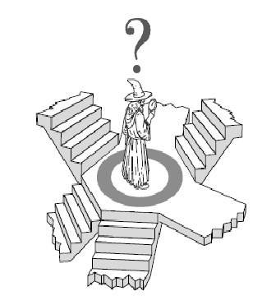
Lecture 13-14
Chapter 4
Beyond Classical Search
Local Search Algorithms
hill climbing, simulated annealing, Beam Search

Slide 4
Outline
Hill-Climbing Search
Simulated Annealing Search
Beam Search

Slide 5
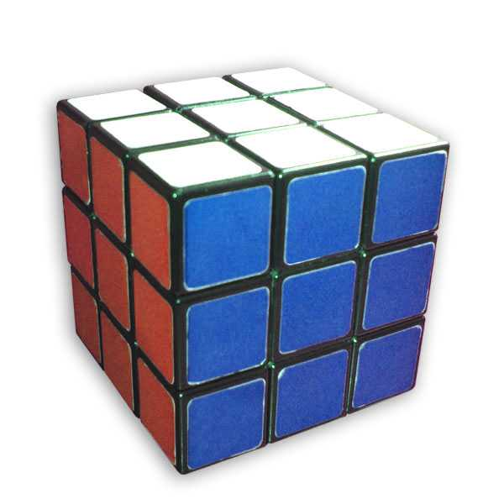
Local Search
In many problems, however, the path to the goal is irrelevant. e.g., Rubik’s cube.
For such cases, we do a local search e.g., instead of memorizing nodes, we only expand the current node, find the best child, expand it, then find its best child, then expand it and so on.
Advantages: low memory and working in a large state space graph (large value of m and d)

Slide 6
Local Search Algorithms
In many optimization problems, the path to the goal is irrelevant; the goal state itself is the solution
State space = set of configurations
Find a configuration satisfying your constraints, e.g., n-queens
Find the best possible state according to a given objective function
In such cases, we can use local search algorithms
Keeps a single "current" state, and then shift states, but don’t keep track of paths.
Use very limited memory
Find reasonable solutions in large state spaces.

Slide 7
Local search Strategy
Key idea (surprisingly simple):
Select (random) initial state (generate an initial guess)
Make local modification to improve current state (evaluate current state and move to other states)
Repeat Step 2 until goal state found (or out of time)

Slide 8
Classical Search vs. Local Search
Classical search | Local Search
systematic exploration of search space. Keeps one or more paths in memory. Records which alternatives have been explored at each point along the path. The path to the goal is a solution to the problem. | In many optimization problems, the path to the goal is irrelevant; the goal state itself is the solution. State space = set of "complete" configurations. Find configuration satisfying constraints, Find best state according to some objective function h(s). e.g., n-queens, h(s)= number of attacking queens. In such cases, we can use Local Search Algorithms.

Slide 9
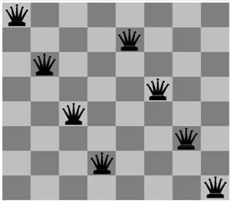
Example: n-queens
Put n queens on an n × n board with no two queens on the same row, column, or diagonal.
In the 8-queens problem, what matters is the final configuration of queens, not the order in which they are added.

Slide 10
Local Search: Key Idea
Key idea:
Select (random) initial state (generate an initial guess).
Make local modification to improve current state (evaluate current state and move to other states).
Repeat Step 2 until goal state found (or out of time).

Slide 11
Local Search: Key Idea
Advantages | Drawback
Use very little memory – usually a constant amount. Can often find reasonable solutions in large or infinite state spaces (e.g., continuous). For which systematic search is unsuitable. | Local Search can get stuck in local maxima and not find the optimal solution.

Slide 12
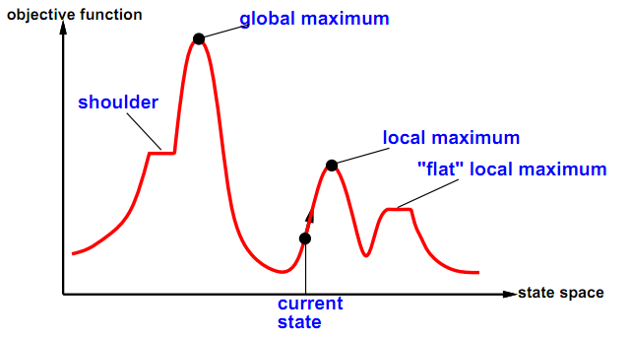
State-Space Landscape
A state space landscape: is a graph of states associated with their costs.
State-space landscape
Location (defined by state)
Elevation (defined by the value of the heuristic cost function or objective function)
If elevation = cost, aim to find the lowest valley (a global minimum)
If elevation = objective function, find the highest peak (a global maximum)
A complete local search algorithm always find a goal if one exists
An optimal algorithm always find a global minimum/maximum
Notes:
Figure shows A one-dimensional state-space landscape in which elevation corresponds to the objective function. The aim is to find the global maximum. Hill-climbing search modifies the current state to try to improve it, as shown by the arrow. The various topographic features are defined in the text.

Slide 13
Local and Global Optima
Global optimum
A solution which is better than all other solutions
Or no worse than any other solution
Local optimum
A solution which is better than nearby solutions
A local optimum is not necessarily a global one

Slide 14
Global / Local (max/min)
A local max/min is over a small area.
For instance, if a point is lower than the next nearest point on the left & right than it's a local min.
There can be many local maxs and mins over an entire graph.
A global max/min is the highest/lowest point on the entire graph.
There can only be ONE gobal max and/or min on a graph.

Slide 15
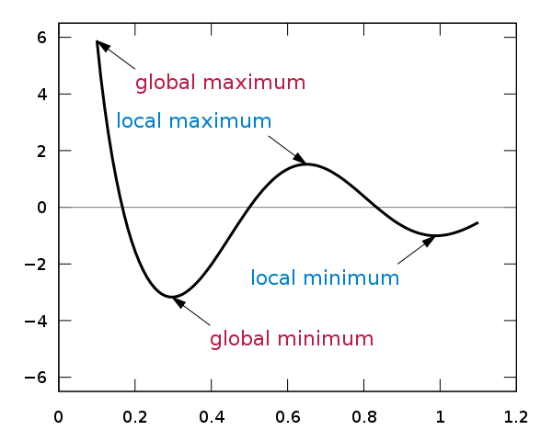
Global / Local (max/min)

Slide 16
Local Search Algorithms

Slide 17
Hill-Climbing Search

Slide 18
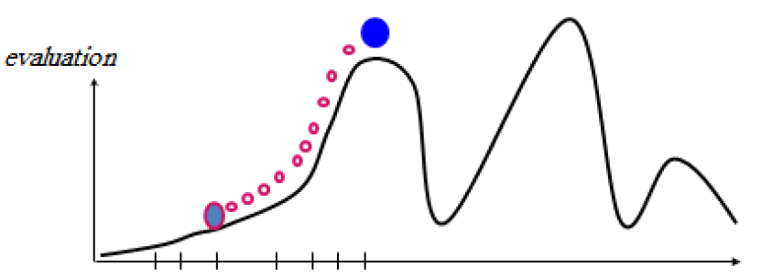

Hill-Climbing Search
Main Idea: Keep a single current node and move to a neighboring state to improve it.
Uses a loop that continuously moves in the direction of increasing value (uphill):
Choose the best successor, choose randomly if there is more than one.
Terminate when a peak reached where no neighbor has a higher value.
It also called greedy local search

Slide 19
Hill-Climbing Search
“Like climbing Everest in thick fog with amnesia”
Only record the state and its evaluation instead of maintaining a search tree
function HILL-CLIMBING ( problem ) returns a state that is a local maximum
inputs: problem, a problem
local variables: current, a node
neighbor, a node
current ← MAKE-NODE( INITIAL-STATE[ problem ])
loop do
neighbor ← a highest-valued successor of current
if VALUE[ neighbor ] ≤ VALUE[ current ] then return STATE[ current ]
current ← neighbor

Slide 20
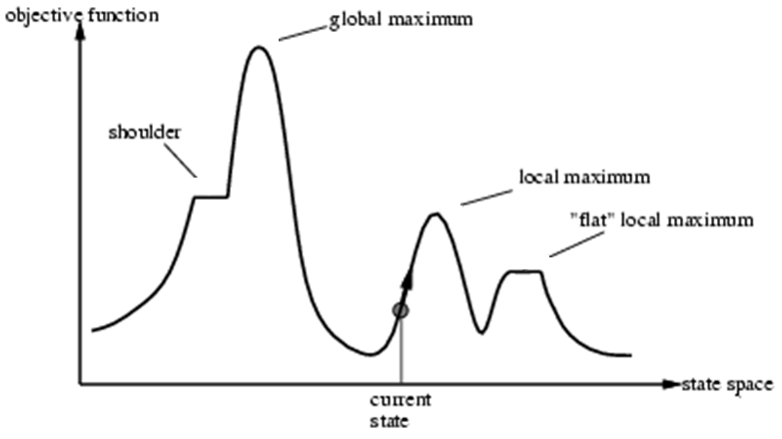
Hill-Climbing Search
it is possible to make progress
attempts to find a better solution by incrementally changing a single element of the solution
Plateaux
Plateaux
Current state

Slide 21
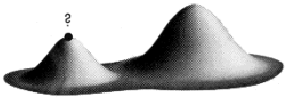
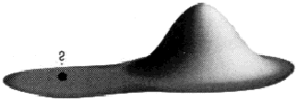
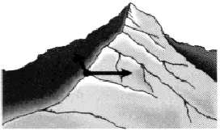
Hill-Climbing Search
Local maxima: a local maximum is a peak that is higher than each of its neighboring states, but lower than the global maximum. Hill-climbing algorithms that reach the vicinity of a local maximum will be drawn upwards towards the peak, but will then be stuck with nowhere else to go.
Plateaux: a plateau is an area of the state space landscape where the evaluation function is flat. It can be a flat local maximum, from which no uphill exit exists, or a shoulder, from which it is possible to make progress.
Ridges: Ridges result in a sequence of local maxima that is very difficult for local search algorithms to navigate.

Slide 22
Hill-Climbing Search Example
our aim is to find a path from S to M
associate heuristics with every node, that is the straight line distance from the path terminating city to the goal city
S
9
A
B
11
7.5
C
8.5
D
8
E
F
9
G
9
6
H
5
I
J
7
K
6
2
L
0
M
N
4
O
4

Slide 23
Hill-Climbing Search Example
S
9
A
B
11
7.5
C
8.5
D
8
E
F
9
G
9
6
H
5
I
J
7
K
6
2
L
0
M
N
4
O
4

Slide 24
Hill-Climbing Search Example
S
9
A
B
11
7.5
C
8.5
D
8
E
F
9
G
9
6
H
5
I
J
7
K
6
2
L
0
M
N
4
O
4

Slide 25
Hill-Climbing Search Example
S
9
A
B
11
7.5
C
8.5
D
8
E
F
9
G
9
6
H
5
I
J
7
K
6
2
L
0
M
N
4
O
4

Slide 26
Hill-Climbing Search Example
S
9
A
B
11
7.5
C
8.5
D
8
E
F
9
G
9
6
H
5
I
J
7
K
6
2
L
0
M
N
4
O
4

Slide 27
Hill-Climbing Search Example
Local Maximum
From A find a solution where
H and K are final states
10
A
10
B
7
F
8
J
4
D
C
E
3
G
2
5
0
K
I
6
0
H
K
0

Slide 28
Hill-Climbing Search Example
Local Maximum
10
A
10
B
7
F
8
J
4
D
C
E
3
G
2
5
0
K
I
6
0
H
K
0

Slide 29
Hill-Climbing Search Example
Local Minimum
10
A
10
B
7
F
8
J
4
D
C
E
3
G
2
5
0
K
G is local minimum
I
6
0
H
K
0
Hill climbing is sometimes called greedy local search because it grabs a good neighbor
state without thinking ahead about where to go next.

Slide 30
Hill-Climbing Algorithm
Pick a random point in the search space
Consider all the neighbors of the current state
Choose the neighbor with the best quality and move to that state
Repeat 2 to 4 until all the neighboring states are of lower quality
Return the current state as the solution state.

Slide 31
Hill-Climbing Problems
It teminates when it reaches a peak where no neighbor has a higher value.
Normal hill climbing can get stuck at local maximum/minimum depending upon start/initial/current state.
Unfortunately, hill-climbing
Can get stuck in local maxima
Can be stuck by ridges (a series of local maxima that occur close together)
Can be stuck by plateaux (a flat area in the state space landscape)
Shoulder: if the flat area rises uphill later on
Flat local maximum: no uphill rise exists.

Slide 32
Hill Climbing - Problem
Solution(s)
Random Restart Hill Climbing
Simulated Annealing
Local Beam Search

Slide 33
Random Restart Hill Climbing
local max
52
12
In case of failure in 1st search, restart with a different initial state. Keep repeating the procedure until h==100 state is reached.
If each hill-climbing search has a probability p of success, then the expected number of restarts required is 1/p.
17
51
init 2
30
21
60
init 1
100
(global max)
45
75
local max
25
34
70
17
9
62
37
init 3

Slide 34
Simulated Annealing Search
(Stochastic hill climbing)

Slide 35
Annealing
What does the term annealing mean?
Annealing, in metallurgy and materials science, is the process used to temper or harden metals and glass by heating them to a high temperature and then gradually cooling them, thus allowing the material to reach a low energy crystalline state.

Slide 36
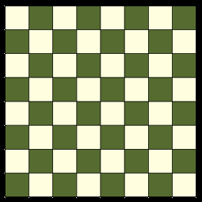
Simulated Annealing Search
Main Idea: escape local maxima by allowing some "bad" moves but gradually decrease their frequency.
Select a neighbor at random.
If better than current state go there.
Otherwise, go there with some probability.
Probability goes down with time (similar to temperature cooling)

Slide 37
Simulated annealing search
Initialize current to starting state
For i = 1 to ∞
If T(i) = 0 return current
Let next = random successor of current
Let Δ = value(next) – value(current)
If Δ > 0 then let current = next
Else let current = next with probability exp(Δ/T(i))

Slide 38
Local Beam Search

Slide 39
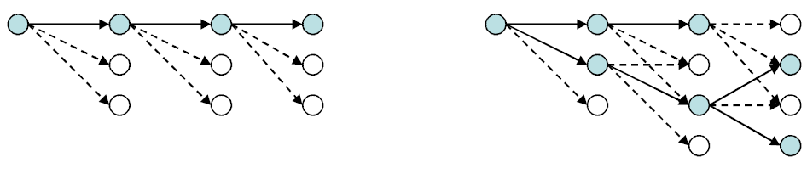
Local beam search
Main Idea: Keep track of k states rather than just one.
Start with k randomly generated states.
At each iteration, all the successors of all k states are generated.
If any one is a goal state, stop; else select the k best successors from the complete list and repeat.
Drawback: the k states tend to regroup very quickly in the same region → lack of diversity.
Is this the same as running k greedy searches in parallel?
Greedy search
Beam search

Slide 40
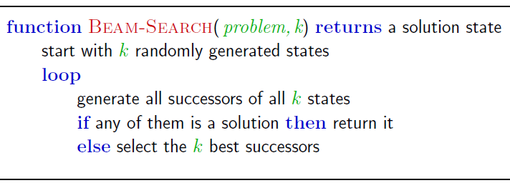
Local beam search
Instead of keeping only one node in memory
Keep track of k states
Start with k randomly generated states
For each step, generate the successors of all k states
If anyone is a goal, the algorithm halts
Otherwise selects the k best successors from the complete list and repeats

Slide 41
Local Beam Search
local max
52
12
Start with k randomly generated states
Generate all successors of those k states
If no goal found, select best k successors and repeat.
For the tree on the right, k =3
17
51
30
21
60
45
75
100
(global max)
local max
25
34
70
17
9
62
37

Slide 42
Local Beam Search
local max
52
12
Generate all successors of those k states
Among these successors (yellow) choose, top 3 since k=3.
17
51
30
21
60
45
75
100
(global max)
local max
25
34
70
17
9
62
37

Slide 43
Local Beam Search
local max
52
12
For these 3, repeat the same procedure until state with h=100 is reached.
17
51
30
21
60
45
75
100
(global max)
local max
25
34
70
17
9
62
37

Slide 44
Local Beam Search
local max
52
12
New children are generated
17
51
30
21
60
45
75
100
(global max)
local max
25
34
70
17
9
62
37

Slide 45
Local Beam Search
local max
52
12
Best 3 are selected.
17
51
30
21
60
45
75
100
(global max)
local max
25
34
70
17
9
62
37

Slide 46
Local Beam Search
local max
52
12
One of the successors is a goal (global max) !
17
51
30
21
60
45
75
100
(global max)
local max
25
34
70
17
9
62
37

Slide 47
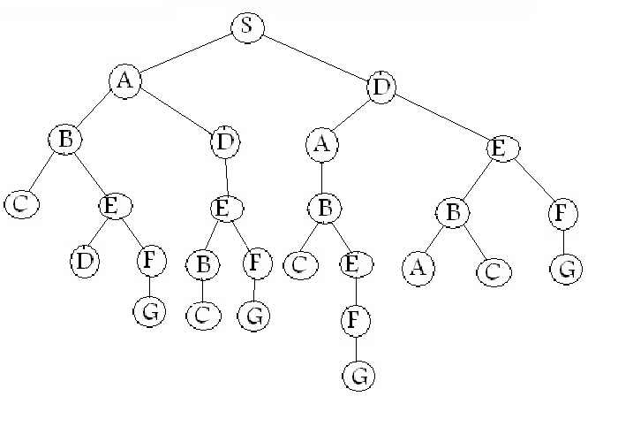
Beam Search – An Example
Let H for each node is given and w = 2
Find the (optimal) path from S to G
H=10.4
H=8.9
H=10.4
H=6.9
H=6.7
H=8.9
H=6.9
H=6.7
H= 4
H=10
H=3.0
H=8
H=9
H=3
H=2
H=5
H= 2
H=10.4
H= 5
H= ∞
H= ∞
H=3
H=0
H=0
H= 7
H=0
H=0

Slide 48
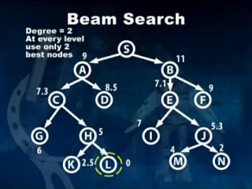
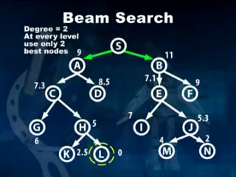
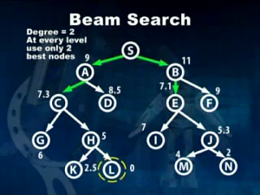
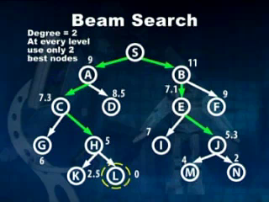
48

Slide 49
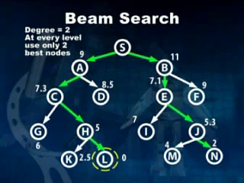
49

Slide 50
Properties
Since a goal state could potentially be pruned, beam search sacrifices completeness (the guarantee that an algorithm will terminate with a solution, if one exists).
Beam search is not optimal (that is, there is no guarantee that it will find the best solution). It returns the first solution found.

Slide 51
Summary
Local search (Iterative improvement) algorithms keep only a single state in memory.
Can get stuck in local extrema(maxima/minima); simulated annealing provides a way to escape local extrema, and is complete and optimal given a slow enough cooling schedule.
Simulated annealing, local search – are heuristics that usually produce sub-optimal solutions since they may terminate at local optimal solution.

Slide 52
Summary
Local beam search keeps track of k states, rather than one state. Quickly abandon useless path, but suffer from lack of diversity.

Slide 53

Questions

